Slide 1
Adversarial Search 2
(Game Playing)

Slide 2
Outline
Motivation
Optimal decisions
Minimax algorithm
α-β pruning

Slide 3
Alpha Beta Pruning

Slide 4
Limitation of Minimax search
Minimax algorithm requires expanding the entire state-space.
Severe limitation, especially for problems with a large state-space.
Some nodes in the search can proven to be irrelevant to the outcome of the search

Slide 5
Alpha Beta Pruning
Idea: If we have an idea that is surely bad, do not take time to see how truly awful it is.
Ex: If we know half-way through a calculation that it will fail, then there is no point doing the rest of it.

Slide 6
A 2-ply Game tree – Ex1
MAX
A1
A2
A3
1st ply
MIN
2nd ply
A11
A12
A13
A21
A22
A23
A31
A32
A33
3
12
8
2
4
6
14
5
2
Note: An action by one player is called a ply, two ply (a action and a counter action) is called a move.
MAX nodes are denoted as and MIN nodes as inverted.

Slide 7
Alpha-Beta Pruning Example
>=3
  Max (3, Min(2,x,y) …) is always ≥ 3
A1
A2
A3
3
≤ 2
≤14
≤5
2
A11
A12
A13
A21
A22
A23
A31
A32
A33
3
12
8
2
x
y
14
5
2
We know this without knowing x and y

Slide 8
Alpha-Beta Pruning Example
MINIMAX( root) = max(min(3, 12, 8), min(2, x, y), min(14, 5, 2))
= max(3, min(2, x, y), 2)
= max(3, z,2)
= 3 where z = min(2, x, y) <= 2
In other words, the value of the root and hence the minimax decision are independent of the values of the pruned leaves x and y.

Slide 9
General alpha-beta pruning
Alpha-beta pruning can be applied to trees of any depth
It is often possible to prune entire sub trees rather than just leaves.

Slide 10
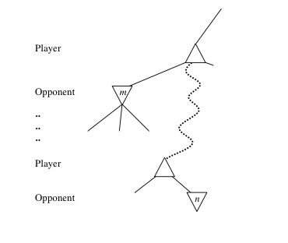
General alpha-beta pruning
Consider a node n in the tree ---
If player has a better choice m at:
  Parent node of n
  Or any choice point further up
Then n will never be reached in play
So once we have found out about n (by examining some of its descendants) to reach this conclusion, we can prune it.

Slide 11
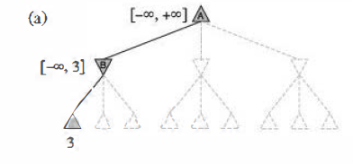
alpha-beta pruning
(a) The first leaf below B has the value 3. Hence, B, which is a MIN node, has a value of at most 3.

Slide 12
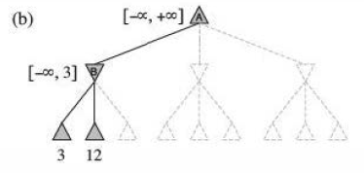
alpha-beta pruning
(b) The second leaf below B has a value of 12; MIN would avoid this move, so the value of B is still at most 3.

Slide 13
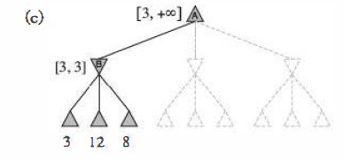
alpha-beta pruning
(c) The third leaf below B has a value of 8; we have seen all B's successor states, so the value of B is exactly 3.
Now, we can infer that the value of the root is at least 3, because MAX has a choice worth 3 at the root.

Slide 14
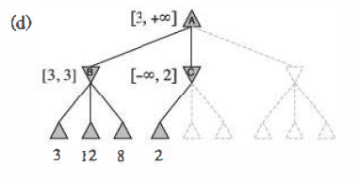
alpha-beta pruning
(d) The first leaf below C has the value 2. Hence, C, which is a MIN node, has a value of at most 2.
But we know that B is worth 3, so MAX would never choose C.
Therefore, there is no point in looking at the other successor states of C.
This is an example of alpha-beta pruning.

Slide 15
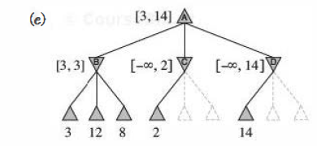
alpha-beta pruning
(e) The first leaf below D has the value 14, so D is worth at most 14.
This is still higher than MAX's best alternative (i.e., 3), so we need to keep exploring D's successor states.
Notice also that we now have bounds on all of the successors of the root, so the root's value is also at most 14.

Slide 16
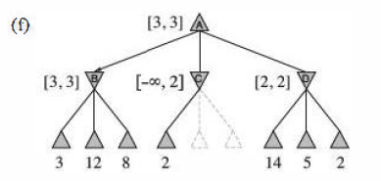
alpha-beta pruning
(f) The second successor of D is worth 5, so again we need to keep exploring.
The third successor is worth 2, so now D is worth exactly 2.
MAX's decision at the root is to move to B, giving a value of 3.

Slide 17
Alpha-beta Algorithm
Depth first search
  only consider nodes along a single path from root at any time
α = highest-value choice found at any choice point of path for MAX (initially, α = −infinity)
β = lowest-value choice found at any choice point of path for MIN (initially, β = +infinity)
Pass current values of α and β down to child nodes during search.
Update values of α and β during search:
  MAX updates α at MAX nodes
  MIN updates β at MIN nodes
Prune remaining branches at a node when α ≥ β

Slide 18
alpha-beta pruning
alpha = the value of the best (i.e., highest-value) choice we have found so far at any choice point along the path for MAX.
beta = the value of the best (i.e., lowest-value) choice we have found so far at any choice point along the path for MIN.
Alpha-beta search updates the values of alpha and beta as it goes along and
prunes the remaining branches at a node (i.e., terminates the recursive call) as soon as the value of the current node is known to be worse than the current alpha or beta value for MAX or MIN, respectively

Slide 19
Alpha Value
An alpha value is an initial or temporary value associated with a MAX node.
Because MAX nodes are given the maximum value among their children,
an alpha value can never decrease; it can only go up.

Slide 20
Beta Value
A beta value is an initial or temporary value associated with a MIN node.
Because MIN nodes are given the minimum value among their children,
a beta value can never increase; it can only go down.

Slide 21
Alpha Beta Procedure
Depth first search of game tree, keeping track of:
  Alpha: Highest value seen so far on Max nodes (maximizing level)
  Beta: Lowest value seen so far on MIN nodes (minimizing level)
Pruning
  When Maximizing,
    do not expand any more sibling nodes once a node has been seen whose evaluation is smaller than Alpha
    When maximizing, cut off values lower than Alpha
  When Minimizing,
    do not expand any sibling nodes once a node has been seen whose evaluation is greater than Beta
    When minimizing, cut off values greater than Beta

Slide 22
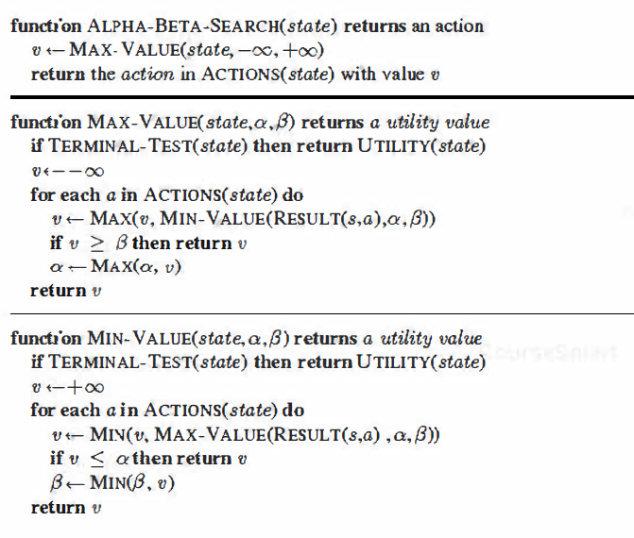
alpha-beta pruning

Slide 23
Alpha Beta Procedure – Trace

Slide 24
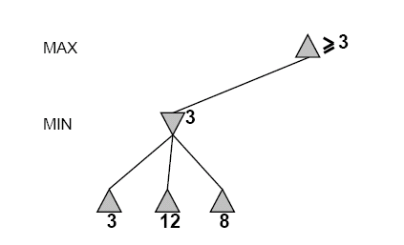
Alpha-Beta Example Ex1 Revisited
Do DF-search until first leaf
α, β, initial values
α=−∞
β =+∞
α, β, passed to child nodes
α=−∞
β =+∞

Slide 25
Alpha-Beta Example (continued)
α=−∞
β =+∞
α=−∞
β =3
MIN updates β, based on child nodes

Slide 26
Alpha-Beta Example (continued)
α=−∞
β =+∞
α=−∞
β =3
MIN updates β, based on child nodes
No change.

Slide 27
Alpha-Beta Example (continued)
MAX updates α, based on child nodes
α=3
β =+∞
3 is returned
as node value.

Slide 28
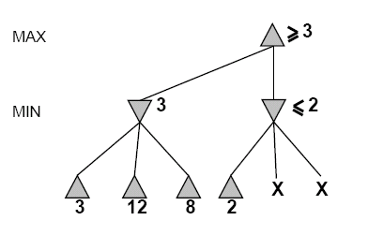
Alpha-Beta Example (continued)
α=3
β =+∞
α, β, passed to child nodes
α=3
β =+∞

Slide 29
Alpha-Beta Example (continued)
α=3
β =+∞
MIN updates β,
based on child nodes.
α=3
β =2

Slide 30
Alpha-Beta Example (continued)
α=3
β =+∞
α=3
β =2
α ≥ β,
so prune.

Slide 31
Alpha-Beta Example (continued)
MAX updates α, based on child nodes
No change.
α=3
β =+∞
2 is returned
as node value.

Slide 32
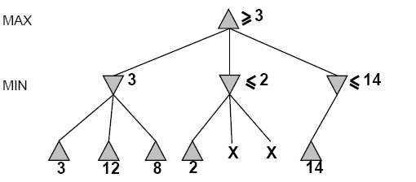
Alpha-Beta Example (continued)
α=3
β =+∞
,
α, β, passed to child nodes
α=3
β =+∞

Slide 33
Alpha-Beta Example (continued)
α=3
β =+∞
,
MIN updates β,
based on child nodes .
α=3
β =14

Slide 34
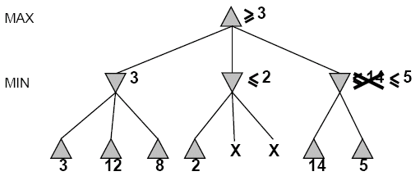

Alpha-Beta Example (continued)
α=3
β =+∞
,
MIN updates β,
based on child nodes
α=3
β =5

Slide 35
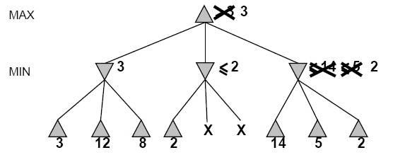
Alpha-Beta Example (continued)
α=3
β =+∞
2 is returned
as node value.
2

Slide 36
Alpha-Beta Example (continued)
Max calculates the same node value, and makes the same move!
2

Slide 37
alpha-beta pruning

Slide 38
Analysis of alpha Beta Pruning

Slide 39
Analysis of alpha Beta Pruning
For the same tree, different move orderings give different cut branches.
If a node can evaluate a child with the best possible outcome earlier, then it can decide to cut earlier.
For a MIN node, this means to evaluate the child branch that gives the lowest value first.
For a MAX node, this means to evaluate the child branch that gives the highest value first.

Slide 40
Effectiveness of Alpha-Beta Search
The effectiveness of alpha-beta pruning is highly dependent on the order in which the states are examined.
Example: we could not prune any successors of D
  because the worst successors (from the point of view of MIN) were generated first.
  If the third successor of D had been generated first, we would have been able to prune the other two.
This suggests that it might be worthwhile to try to examine first the successors that are likely to be best.

Slide 41
A 2-ply Game tree – Ex1
MAX
A1
A2
A3
1st ply
MIN
2nd ply
A11
A12
A13
A21
A22
A23
A31
A32
A33
3
12
8
2
4
6
14
5
2

Slide 42
Alpha-Beta Example
2

Slide 43
Effectiveness of Alpha-Beta Search
Best-Case
  each player’s best move is the left-most child (i.e., evaluated first)
  E.g., sort moves by the remembered move values found last time.
  E.g., expand captures first, then threats, then forward moves, etc. (chess game)

Slide 44
Effectiveness of Alpha-Beta Search
Worst-Case
  branches are ordered so that no pruning takes place
  alpha-beta gives no improvement over exhaustive search
Best-Case
  each player’s best move is the left-most alternative (i.e., evaluated first)
In practice often O(b^(m/2)) rather than O(b^m)
  this is the same as having a branching factor of sqrt(b),
    since (sqrt(b))^m = b^(m/2)
    i.e., Effective branching factor is square root of b instead of b
  e.g., in chess go from b ~ 35 to b ~ 6
    this permits much deeper search in the same amount of time
    makes computer chess competitive with humans!

Slide 45
Alpha-Beta Pruning - Summary
Pruning does not affect final results
Entire subtrees can be pruned.
Good move ordering improves effectiveness of pruning
Repeated states are again possible.
  Store them in memory = transposition table

